Slide 1













Data Science Capstone
2.8
Million Social Media posts
2.5
Million Website search queries
27.2
Thousand Review posts
100
Hours of Online videos
201
Million emails sent
EVERY MINUTE
57
Thousand Pictures posts
50.7
Thousand Thoughts posts
Final Project
Shubhamkar Giridhar

Slide 2
Business Problem
Nowadays people mostly resort to going to malls or big retail chains to purchase their daily stuff. The advantage of going to big retail chains is that one gets all their necessary items just at one place. From groceries to clothes, from sport sequipment’s to stationaries …You name it and you get it!!! Also big hotels, cafe, pubs are one of the most important customers of the retail chains because they purchase their goods in bulk. So, I am aiming to develop a recommender system for these retail outlet chains which would give them a good strategic location for them to open their outlets and make a good profit.
Strategic Location is one of the most important factor for any business to succeed. If the location is bad, no matter how much we invest the business wouldn’t be making any profits. Recently one of the biggest retail chains Walmart decided to close 269stores because it was resulting in a loss. Such a mass closure doesn’t affect only the retail chain shareholders but also affect the employment and lives of the people working in such stores. It was estimated that 16,000 people were affected due to the mass closure. This is a very good example which strengthens the claim that ‘Location is one of the most important aspect for any business to succeed’.
This Recommendation System Will Help !
Data
Original Dataframe obtained from Wikipedia
Postal code
PostalCode | Borough | Neighbourhood | Latitude | Longitude
0 | M3A | North York | Parkwoods | 43.753259 | -79.329656
1 | M4A | North York | Victoria Village | 43.725882 | -79.315572
2 | M5A | Downtown Toronto | Harbourfront | 43.654260 | -79.360636
Borough
Neighborhood

Slide 3
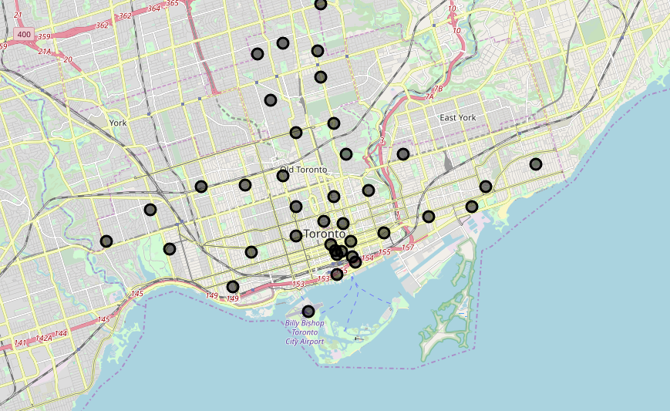
Methodology
The first and the foremost part was to get the data in the correct form which could be used for exploratory data analysis. ‘Folium’ package is one of the best packages available in python to view the location data on the map. Python’s Geopy module is used to get the latitude and the longitude information. Folium centers the map taking in account the latitude and longitude information.
We can view all of the neighborhoods in the Borough by calling folium’s Map function. The Foursquare API is then used to get the location information of the different neighborhood and is used to get the most common venues of each neighborhood .The next task would be to group the similar neighborhood together so it will be easy for the retail chains to decide which location would be the best considering the cafes , coffee shops, hotels ,pubs in that neighborhood.
The machine learning algorithm which would be used to group the similar neighborhood is the Kmeans algorithm from sklearn Cluster library.

Slide 4
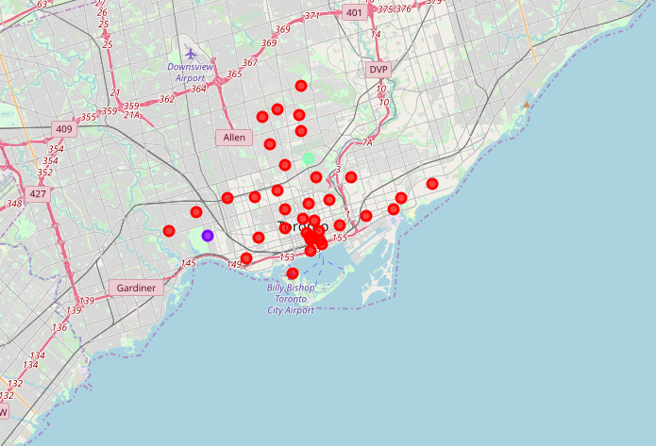
Results
The results can be viewed as a cluster formed by the Kmeans Algorithm which groups the similar data together. All the neighborhood which have been labelled with the same color points fall in the same cluster. Individual clusters can also be visualized to get the details about the what kind of customers could be expected if the retail store outlet is opened at a given location. Big restaurants, coffee shops, hotels usually buy the commodities in bulk. So greater the numbers of such customers in a neighborhood more would be the sale and this would eventually result in good profit margins.

Slide 5
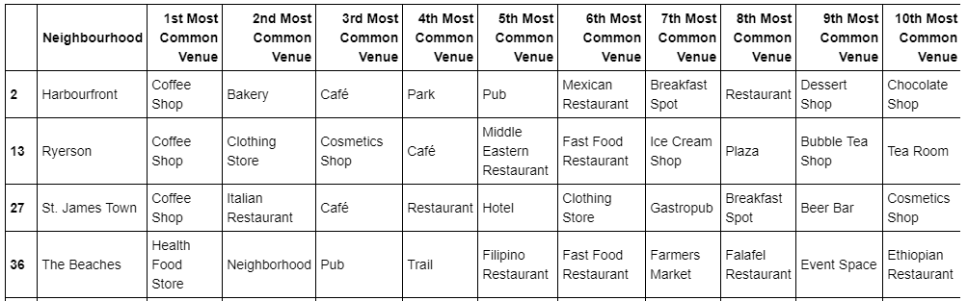
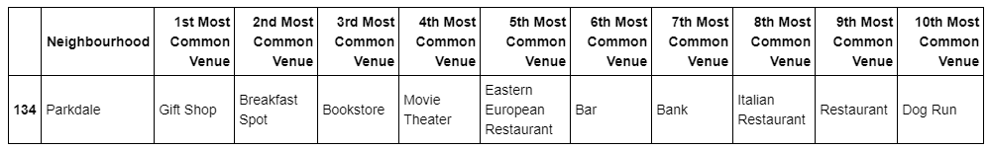
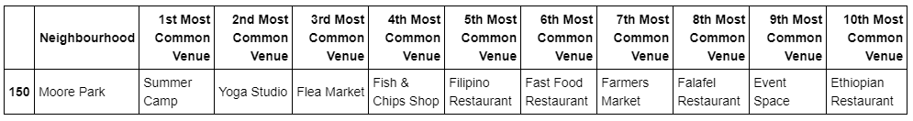
Discussion
Once we visualize the clusters the next step is to analyse the individual clusters to gather important information about them.We first get the venues from the first cluster .
The first cluster can be visualized as
The second cluster can be visualized as
The third cluster can be visualized as
As we can see most of the venues in this neighborhood contains parks, gym , electronic stores ,event space.So the grocery and daily items sale would be very less as compared to neighbourhood from the previous clusters .So this location is not good in terms of opening a store outlet as it will lead to poor sales and would eventually lead to loss

Slide 6
Conclusion
This Projects serves as a very good recommender tool for big retail chains to make a decision whether to open their outlets at a given or specified location . The foursquare API helps to get the most common venues at a location and machine learning help us to cluster these venues depending upon their similarity .Analysis of these clusters would help the retail chains to identify the potential customers and make a decision of opening their outlet stores.

